Slide 1
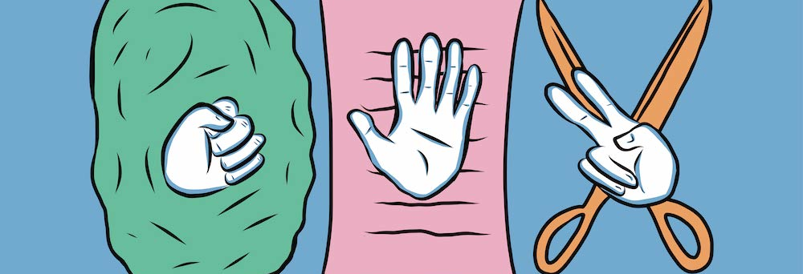
Rock, Paper and Scissors…
Applied Problem Solving,
Workshop - 4
Name: Sampreet Klair
Student Number: 145031225
Course: APS145 - ZDD

Slide 2
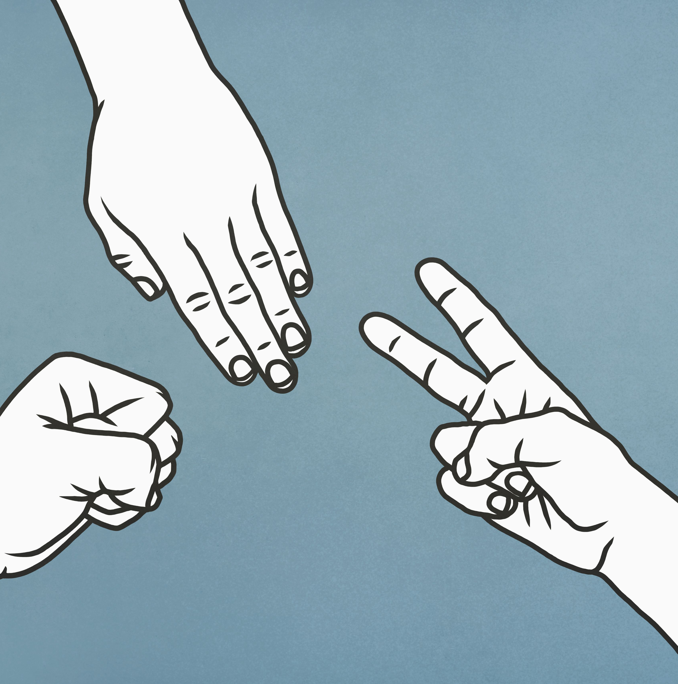
Background:
Rock, paper and scissors, ask any person from any country, speaking any language, having different ethnicity everyone must have played this game once in lifetime. By creating this application, I want to bring this game on the computer screen, and I wish that people of different backgrounds and ages come together to play it.

Slide 3
What is this game?
If you don’t know how to play, this game is very easy and straight forward.
Often two players play this game where the main props used to play are the hands.
Usually both the players synchronically move their hands up and down, then together form rock or paper or scissors using their hands.

Slide 4
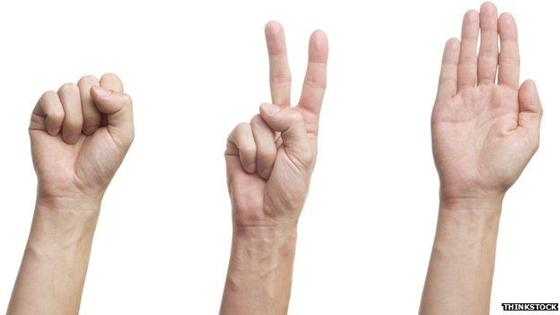
Options to choose from:
There are three possible options to choose from:
Rock, made by showing a closed fist.
Paper, made by showing the palm with all fingers open.
Scissors, made by showing two fingers apart. (index finger and middle finger)

Slide 5
Rules for playing the game:
Rock beats the Scissors and wins a point.
Paper beats the Rock and wins a point.
Scissors beats the Paper and wins a point.
The game can be played once for single
point or it can also be played multiple times
for multiple points.

Slide 6
Possible outcomes:
There are three possible outcomes of the game:
Player wins and Computer losses.
Computer wins and Player losses.
The game is a draw, when both Player and Computer have same option/symbol formed by their hands.

Slide 7
Examples of playing the game:
Player chooses Rock and Computer chooses Scissors Human Player Wins!
Player chooses Rock and Computer chooses Paper Computer Wins!
Player chooses Rock and Computer chooses Rock The game is a Draw!
Player chooses Scissors and Computer chooses Paper Human Player Wins!
Player chooses Scissors and Computer chooses Rock Computer Wins!
Player chooses Scissors and Computer chooses Scissors The game is a Draw!
Player chooses Paper and Computer chooses Rock Human Player Wins!
Player chooses Paper and Computer chooses Scissors Computer Wins!
Player chooses Paper and Computer chooses Paper The game is a Draw!

Slide 8
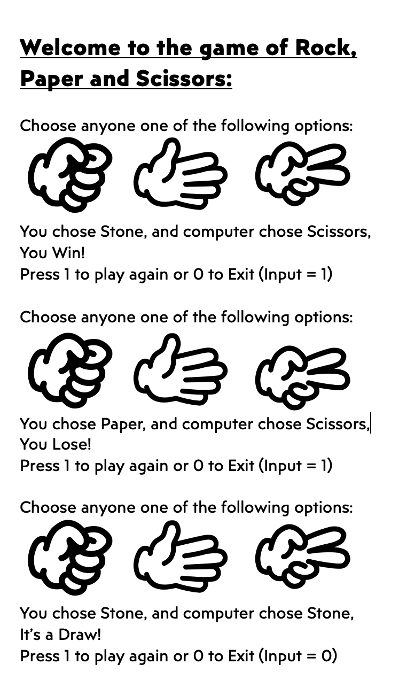
Sample/Mock application

Slide 9
Why our application is the best?
There are many reasons why our application is the best and you should use it:
The process and the rules of playing the game are explained clearly.
The program caterers for the occurrence of draw.
You can get the feel and the joy of playing the game of Rock, Paper and Scissors on the Computer screen very similar to playing it in the real life with friends.

Slide 10
Thank You
Please enjoy playing the game of Rock, Paper and Scissors with all your FRIENDS.

Slide 11
Citation:
https://wrpsa.com/wp-content/uploads/2021/08/finalrps-classypage.jpg
https://hips.hearstapps.com/hmg-prod/images/people-playing-paper-rock-scissors-royalty-free-illustration-1583269312.jpg
https://media3.giphy.com/media/3ohzdGnD5vAud1NCZW/giphy.gif?cid=6c09b952wqlq2lgkyyaloos6bxex8nttdzz3z06y86zdvxzr&ep=v1_gifs_search&rid=giphy.gif&ct=g
https://ichef.bbci.co.uk/news/624/mcs/media/images/74580000/jpg/_74580127_162317629(1).jpg
https://media.tenor.com/OvHQWExcPh0AAAAC/cartoons-being-ian.gif
https://teamhood.com/wp-content/uploads/2022/11/friends-rock-paper-scissors.gif
https://thenounproject.com/api/private/icons/477918/edit/?backgroundShape=SQUARE&backgroundShapeColor=%23000000&backgroundShapeOpacity=0&exportSize=752&flipX=false&flipY=false&foregroundColor=%23000000&foregroundOpacity=1&imageFormat=png&rotation=0
https://thenounproject.com/api/private/icons/477922/edit/?backgroundShape=SQUARE&backgroundShapeColor=%23000000&backgroundShapeOpacity=0&exportSize=752&flipX=false&flipY=false&foregroundColor=%23000000&foregroundOpacity=1&imageFormat=png&rotation=0
https://thenounproject.com/api/private/icons/477919/edit/?backgroundShape=SQUARE&backgroundShapeColor=%23000000&backgroundShapeOpacity=0&exportSize=752&flipX=false&flipY=false&foregroundColor=%23000000&foregroundOpacity=1&imageFormat=png&rotation=0

